Slide 1

Twitter Stock Market Analysis

Slide 2
Introduction
The project analyzes Twitter’s stock market performance using historical data. The aim is to understand stock behavior, detect patterns, and derive insights from both descriptive statistics and visualizations.

Slide 3
Methodology
Data Collection: Imported Twitter stock dataset.
Data Cleaning: Checked for missing values and null entries,
handled them appropriately.
Exploratory Data Analysis: Displayed first 100 rows, analyzed
columns, and generated
descriptive statistics.
Visualization: Created multiple charts for trends and comparisons.

Slide 4
Requirement Analysis
Analyze historical stock prices of Twitter.
Perform statistical analysis to check market behavior.
Build visualizations for stock trends, comparisons, and
insights.
Provide conclusions regarding stock performance over time.

Slide 5
Other Parameters
Time Analysis: Data analyzed year-wise and across entire stock history.
Comparisons: Close vs Date, High vs Low, etc.

Slide 6
Visualizations
Line Graph: Stock prices over the years.
Word Cloud : Visual representation of
column importance or patterns.
Buttons/Filters: Interactive selections for different time
periods.

Slide 7
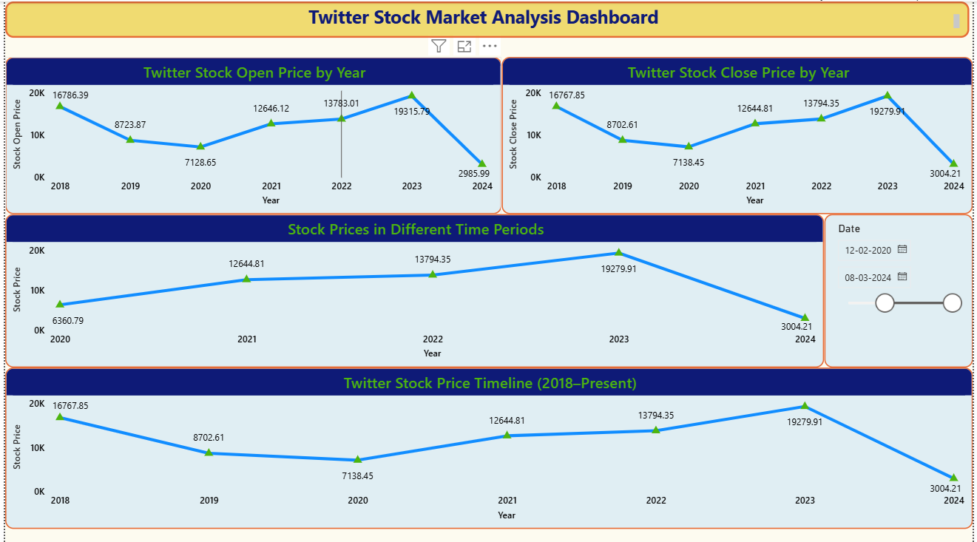

Slide 8
Insights
Stock Trend: Twitter stock prices show clear ups
and downs with volatility across years.
Close Price Movement: Overall trend gives a sense of
long-term growth but includes
significant fluctuations.
Interactive Views: Time-based filters allow detailed
short-term vs long-term insights.

Slide 9
Conclusion
Prices fluctuate significantly, influenced by market events.
Statistical tests show meaningful differences across stock
parameters.
Visualizations reveal clear year-wise and overall trends.
The project successfully demonstrates data cleaning
and visualization for financial data analysis.

